Slide 1
OPM Workshop

Slide 2
AGENDA
1. Product Development
2. Process Execution
3. Costing

Slide 3
AGENDA
1. Product Development
2. Process Execution
3. Costing

Slide 4









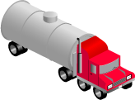



Process Manufacturing Flow
Capture
Customer Demand
Inventory
Management
Quality-Oriented
Process Management
Create
Sales Order
Comprehensive
Process Mfg
Solution
Cost
Management
Recipe & Formula
Development
Process
Management
Ship Product
Supply Chain
Planning
Electronic Batch
Record/E-Signature
Procure
Materials
Multi-Level
Material/Resource
Traceability
Update
Billing & Finance

Slide 5
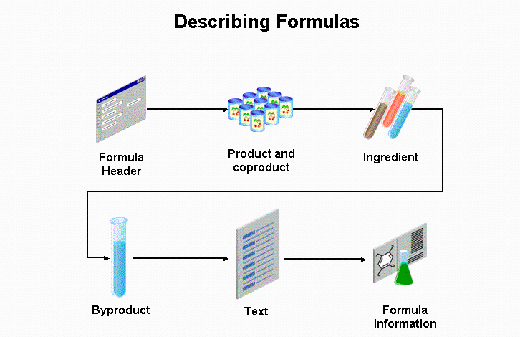

Slide 6
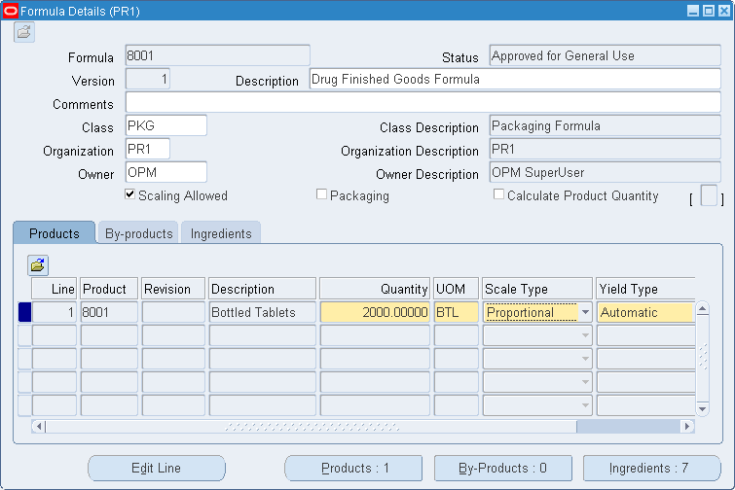
Formula : Product

Slide 7
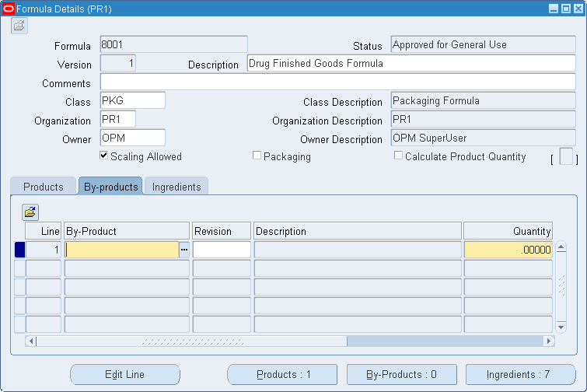
Formula : By-Product

Slide 8
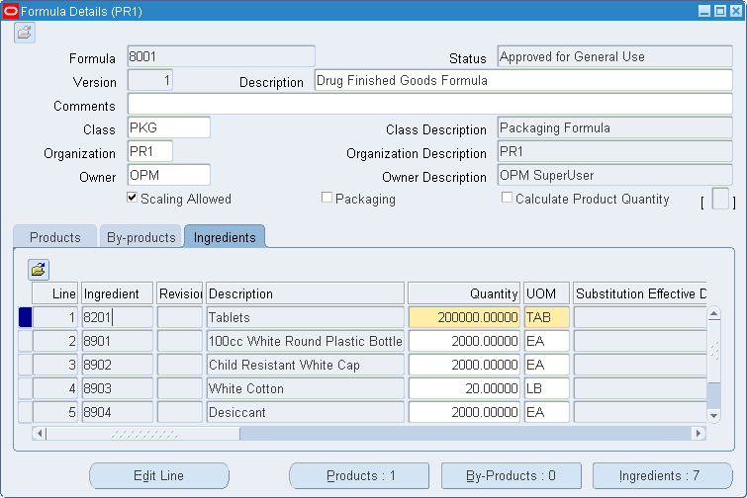
Formula : Ingredients

Slide 9
Process Routing
Transformation Step to Make Product
Resources + Activities = Operations
Blender
+
Run Blender
=
Blending
Blending
+
Extrusion
+
Pack
=
Routing
A Group of Operations = Routing

Slide 10
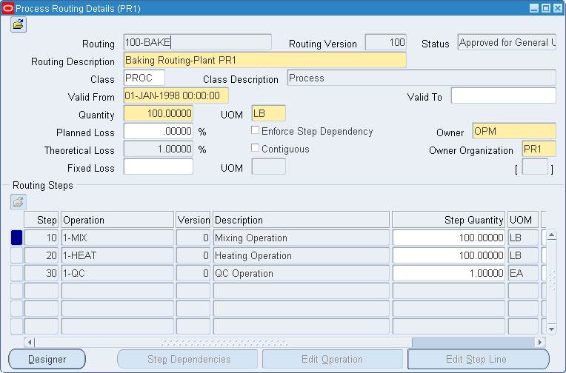
Routing

Slide 11
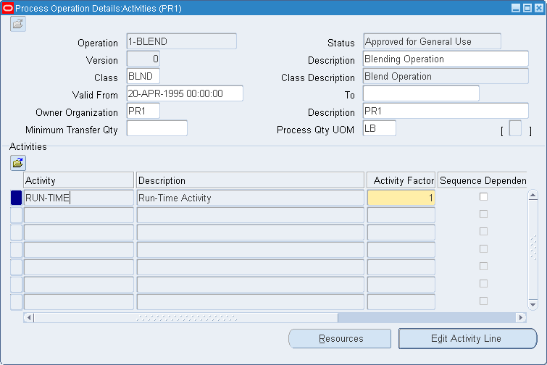
Operations
Operations are a combination of activities performed in a production batch and the resources used to perform those activities.

Slide 12
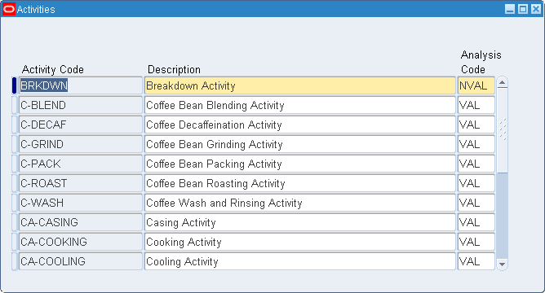
Activities
Activities are actions performed during production.

Slide 13
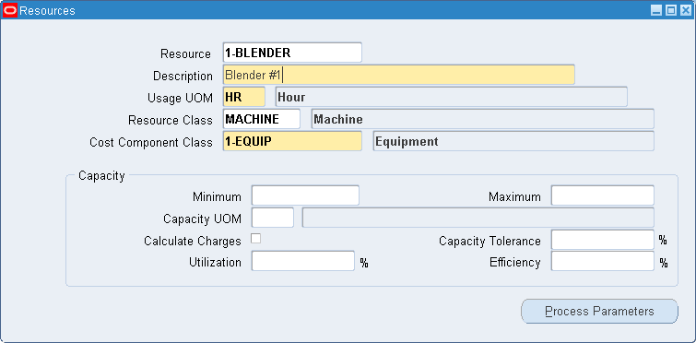
Resource (Generic)
Resources are the assets to produce batches, including production equipment, and employee labor. You can define each resource generally, for example, OVENS, or specifically OVEN 1, OVEN 2 . . . OVEN n. For each resource, assign a classification code for cost management purposes.

Slide 14
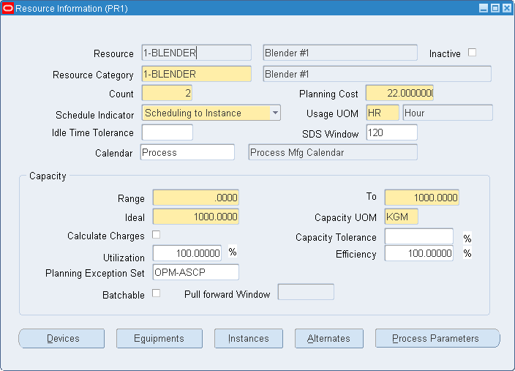
Resource (Plant)
A resource may operate at a different capacity at one production inventory organization than it does at another. For scheduling, the resource must be defined at the inventory organization. If the resource is not enabled at the inventory organization, then it is assumed that the resource does not exist there. Use the Resource Information window to enter inventory organization specific information regarding each resource.

Slide 15
AGENDA
1. Product Development
2. Process Execution
3. Costing

Slide 16
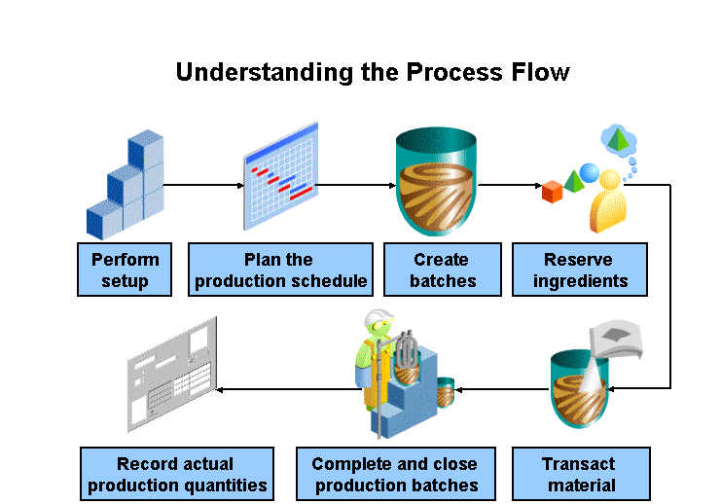

Slide 17
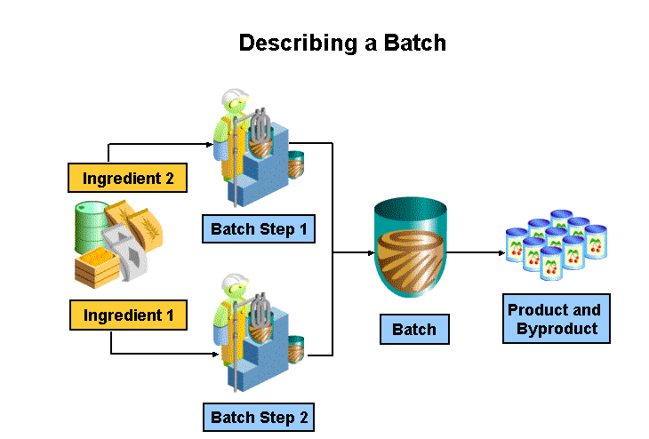

Slide 18
Production Batch Life Cycle
Inventory
Shortage
Check*
Inventory
Shortage
Check*
Auto-Allocation*
Pending
WIP
Certified
Closed
Enter
Release
Certify
Close
Cancel
Unrelease
Revert
to WIP

Slide 19
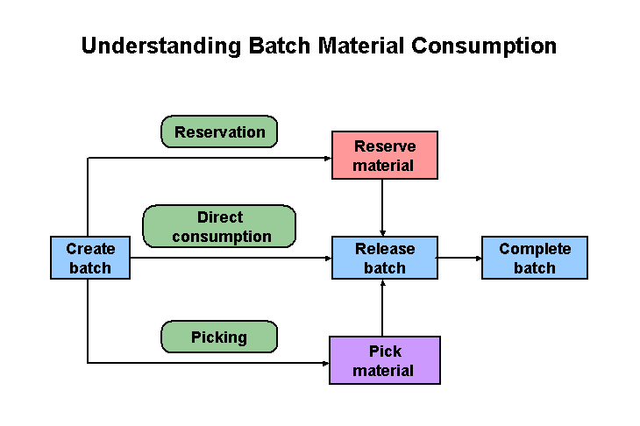

Slide 20
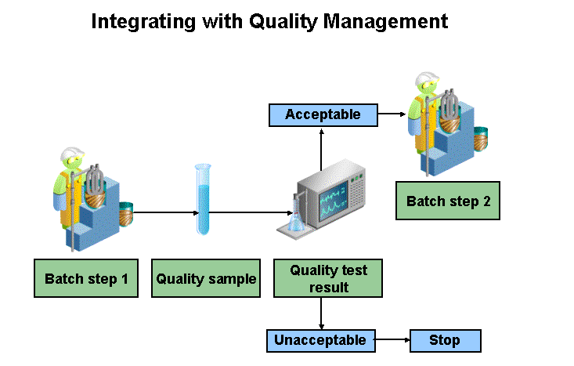

Slide 21
AGENDA
1. Product Development
2. Process Execution
3. Costing

Slide 22
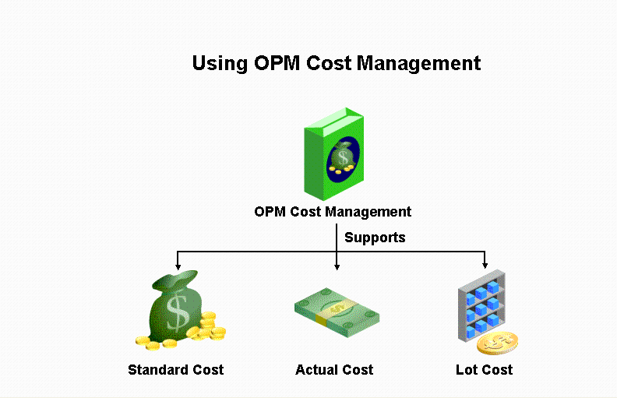

Slide 23
Reviewing Costing Setup
1.
Cost Types
2.
Cost Calendar
3.
Component Groups
4. Component Classes
5. Analysis Code
6.
Costing Organization Associations
7.
GL Fiscal Policy
Step 3. and Step 6. are optional setup step

Slide 24
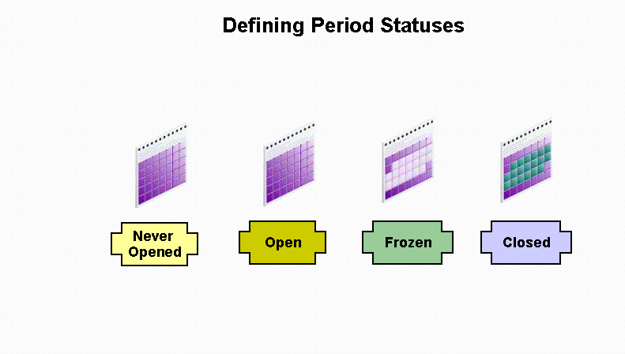

Slide 25
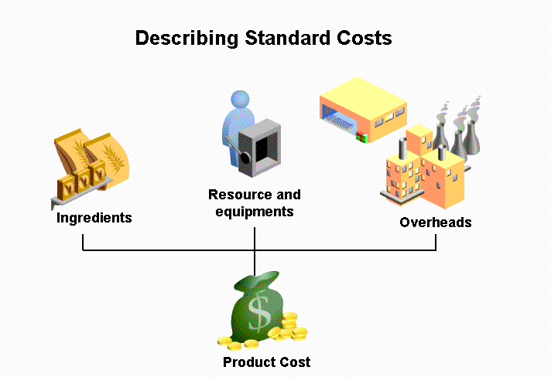

Slide 26
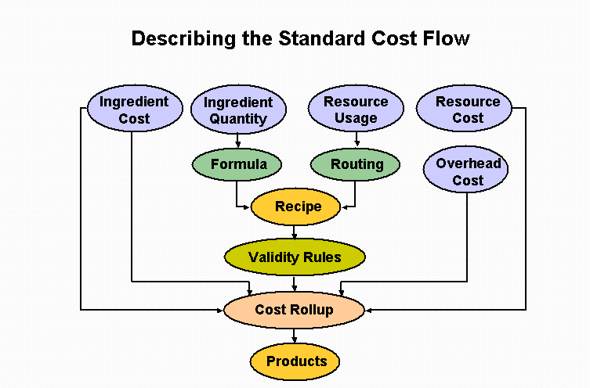

Slide 27
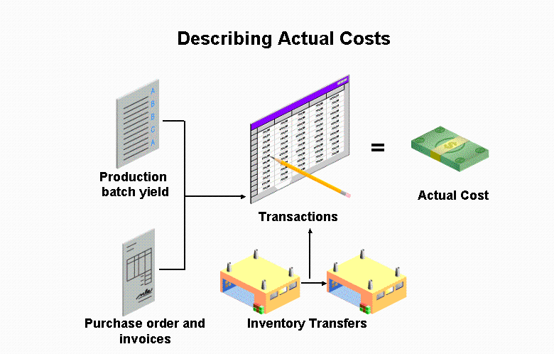

Slide 28
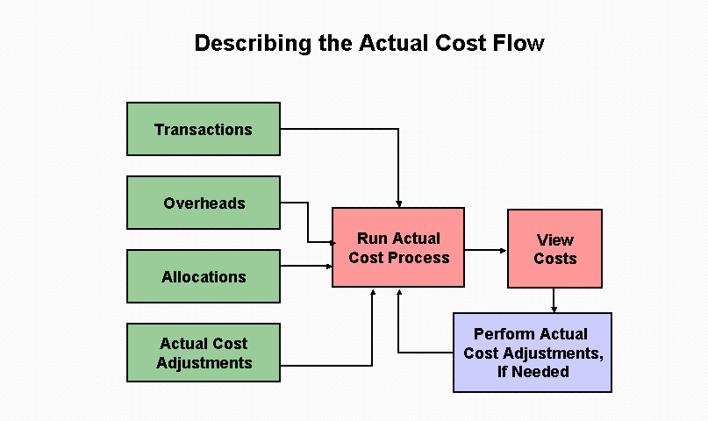

Slide 29
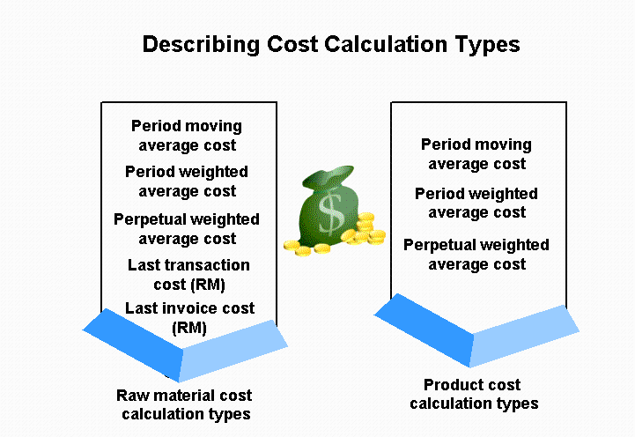

Slide 30
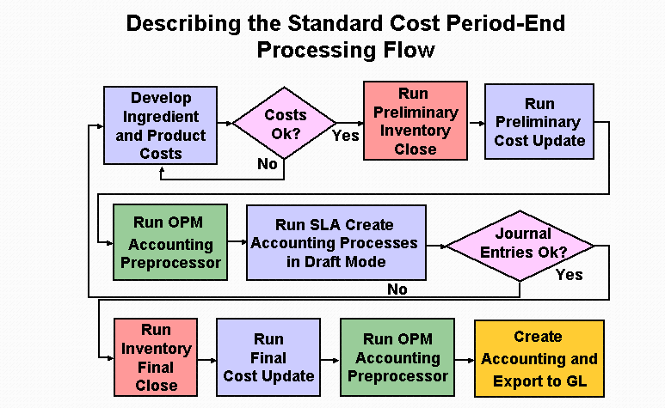

Slide 31
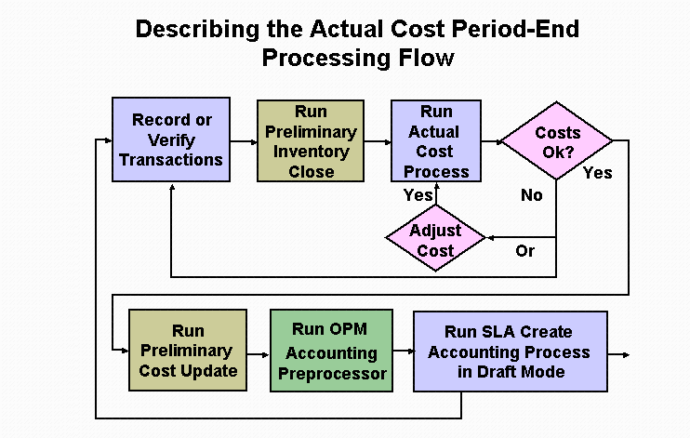

Slide 32
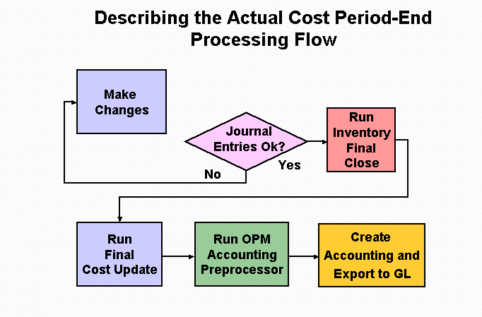

Slide 33


